Slide 1
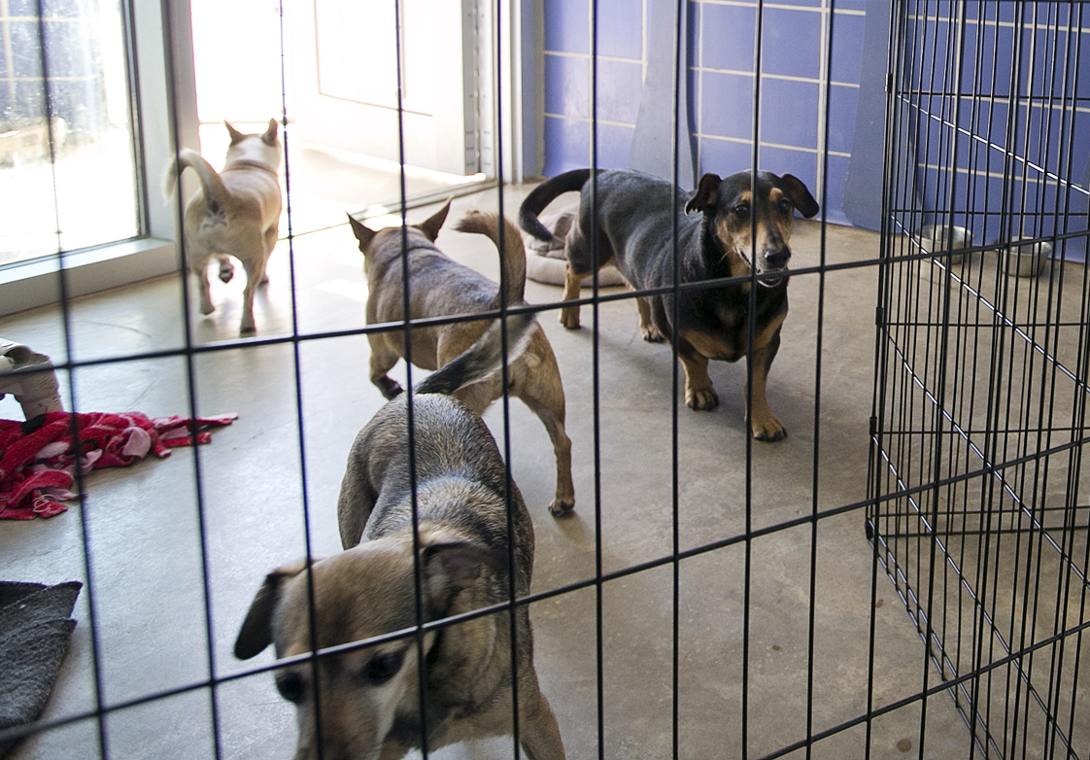
Intro
Data: Austin Animal Center, Dogtime breed descriptions

Slide 2
Intro
Goal: predict length of stay for dogs entering the Austin Animal Center
Learn what characteristics affect the length of stay

Slide 3
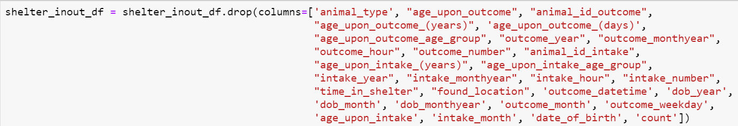
Shelter Dataset: Exploration & Cleaning
Removing Unhelpful Fields:

Slide 4
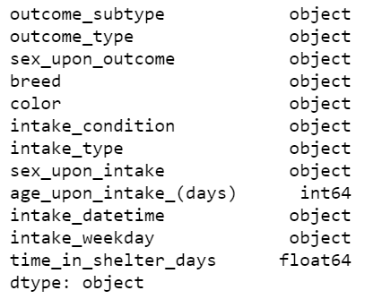
Shelter Dataset: Exploration & Cleaning
Useable variables:

Slide 5
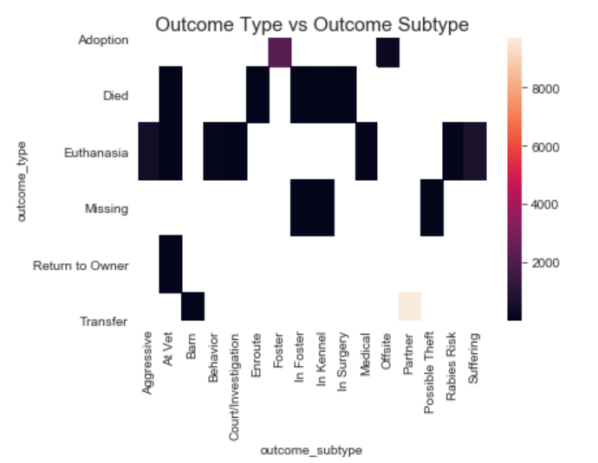
Outcome
Two types of outcome field:

Slide 6
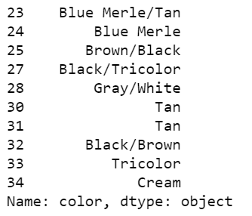
Color
Originally:

Slide 7
Color
Color split into two columns
Color types split off (e.g. Merle removed from Tan Merle)
Color types One Hot Encoded
Both color columns were One Hot Encoded
OHE columns for each color combined

Slide 8
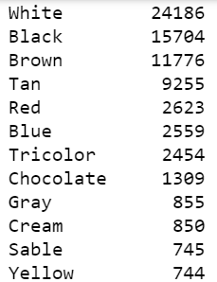
Color
Most common Colors:

Slide 9
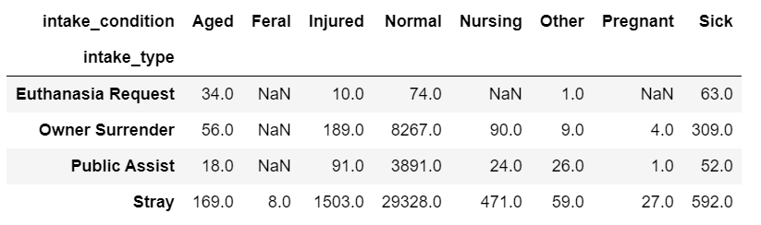
Intake Features
Intake Condition and Type are similar; I did not combine.

Slide 10
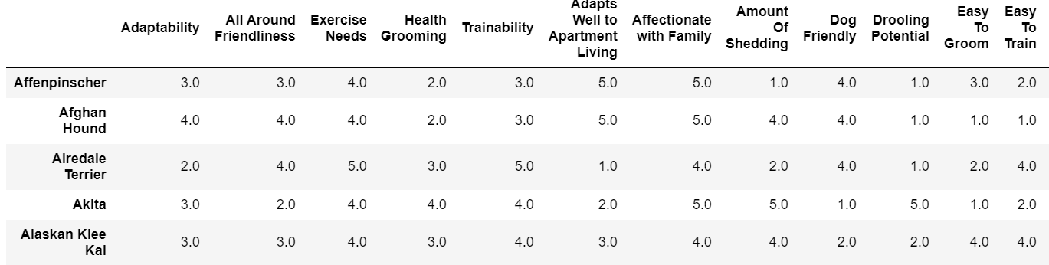
Import Dataset: dog breed description
216 listed breeds, 31 variables
Example of variables and rows:

Slide 11
Initial Feature Selection
Review features in dog breed descriptions and eliminate any highly correlated features

Slide 12
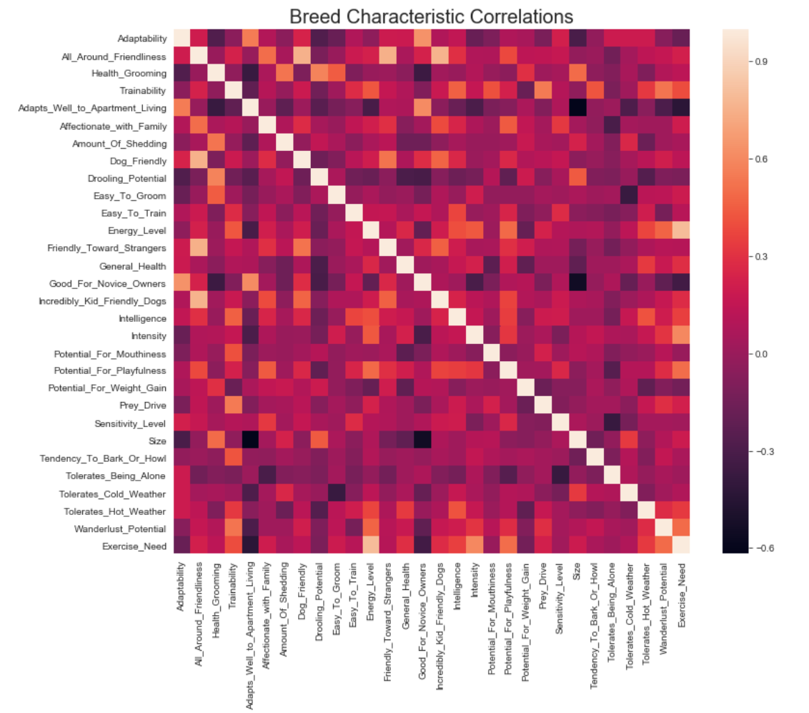

Slide 13
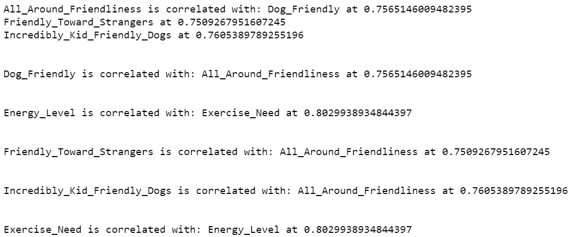
Initial Feature Selection
Use numerical review. Eliminate correlated features, especially those that are measuring nearly the same quality

Slide 14
Feature Augmentation: Combining Datsets
Use the breed descriptions: multiple interval features instead of one highly fragmented categorical variable

Slide 15
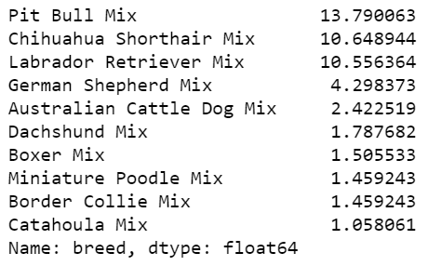
Breed Field Cleaning
Breed has multiple breeds for many animals, and very fragmented.
Most commonly listed breeds by percent of total:

Slide 16
Breed Field Cleaning
Need breed names in shelter data to exactly match breed names in description
Pulled descriptors like ‘Longhair’ out of breed field into new features
Created second breed feature to split listings with two breeds, e.g. “German Shepherd Dog/Golden Retriever”

Slide 17
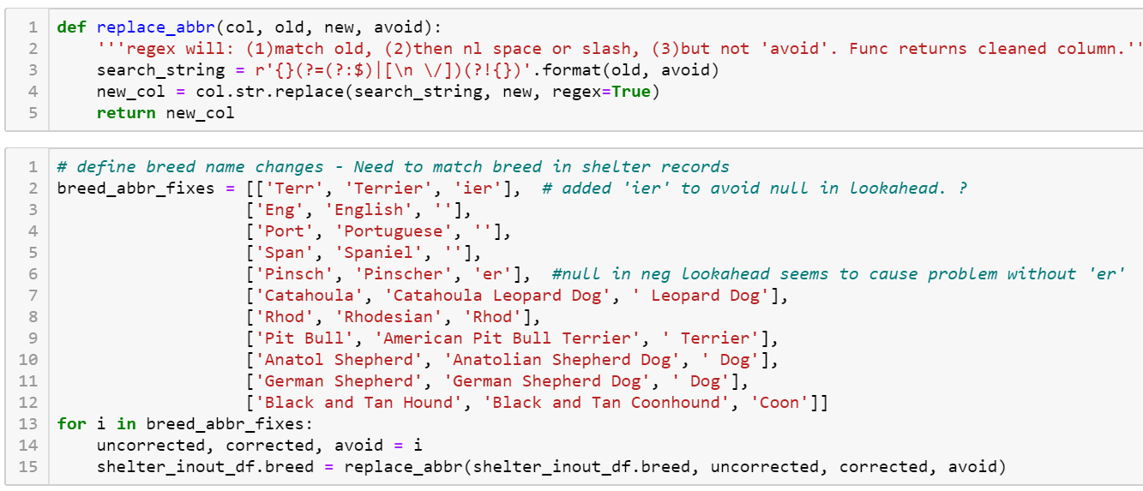
Breed Field Cleaning

Slide 18
Breed Field Cleaning
Cleaned until remaining breeds were not in description dataframe or ambiguous (e.g. there are two breeds know as 'Staffordshire')

Slide 19
Combine DataFrames
Merged dataframes so dog breed description features added to the shelter records
Imported a duplicate set of description features and averaged breed description data for animals with multiple breeds listed
Filled nulls for animals whose breed did not match an entry in the description dataframe. Used feature means.

Slide 20
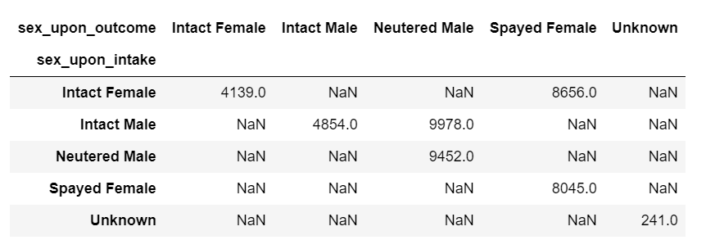
Feature Engineering
Sex/Neutering:

Slide 21
Feature Engineering
Sex/Neutering:
Changed to Sex, Neutered, and Neutered_in_Shelter

Slide 22
Feature Engineering: Datetime
Turned into One Hot Encoded features for the day of week and the season when animal entered the shelter

Slide 23
Feature Selection
Started by splitting data into train & test

Slide 24
Feature Selection: Look for Multicollinearity
Feature Correlation heatmap:

Slide 25
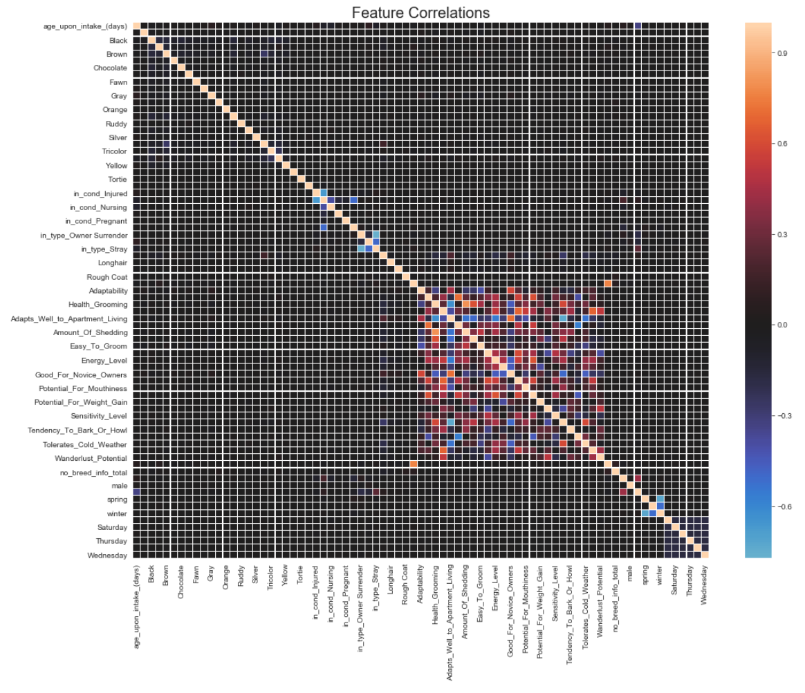

Slide 26
Feature Selection: Look for Multicollinearity
Zoom in on a few features that look like they have important correlations:

Slide 27
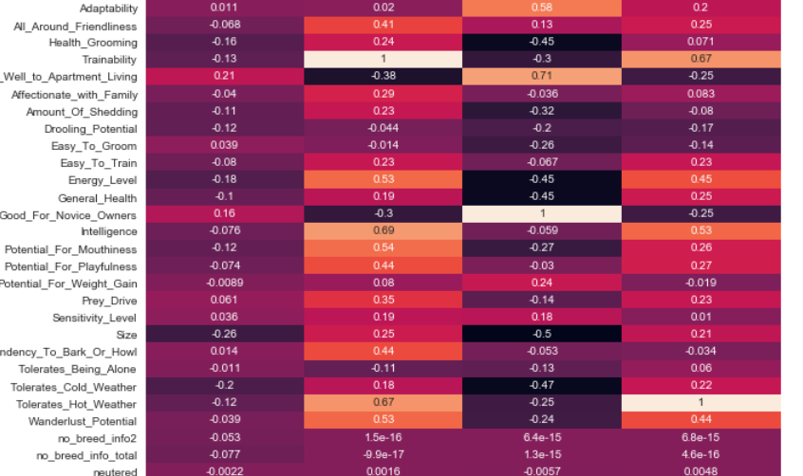

Slide 28
Feature Selection: Look for Multicollinearity
Some multicollinearity but not enough to remove any features

Slide 29
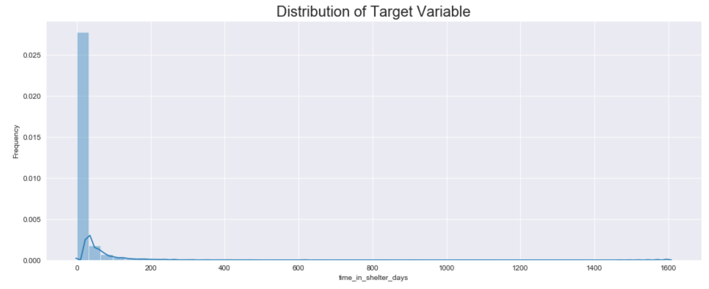
Review Variable Distribution
Distribution of target variable:

Slide 30
Review Variable Distribution
Distribution of target variable:
Strongly right skewed
Very long stays may be a data quality issue or caused by different reasons; stays over 1 year removed.

Slide 31
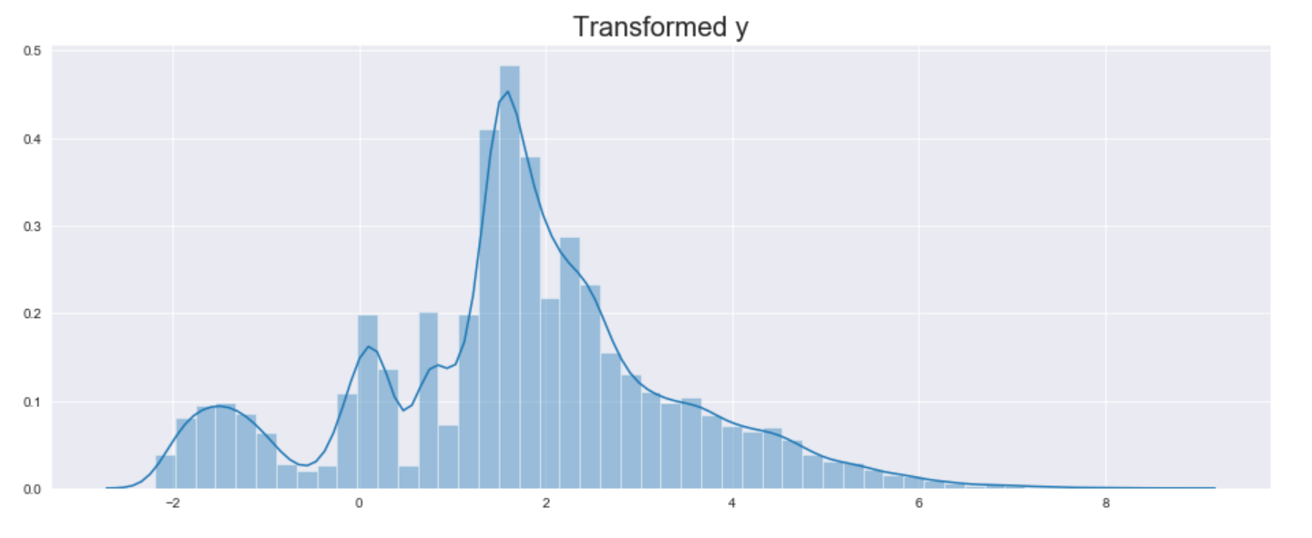
Review Variable Distribution
Box-cox transformation performed on y:

Slide 32
Algorithmic Feature Selection
Boruta feature selection using a random forest estimator
Used perc=50 to reduce chance of eliminating too many features

Slide 33
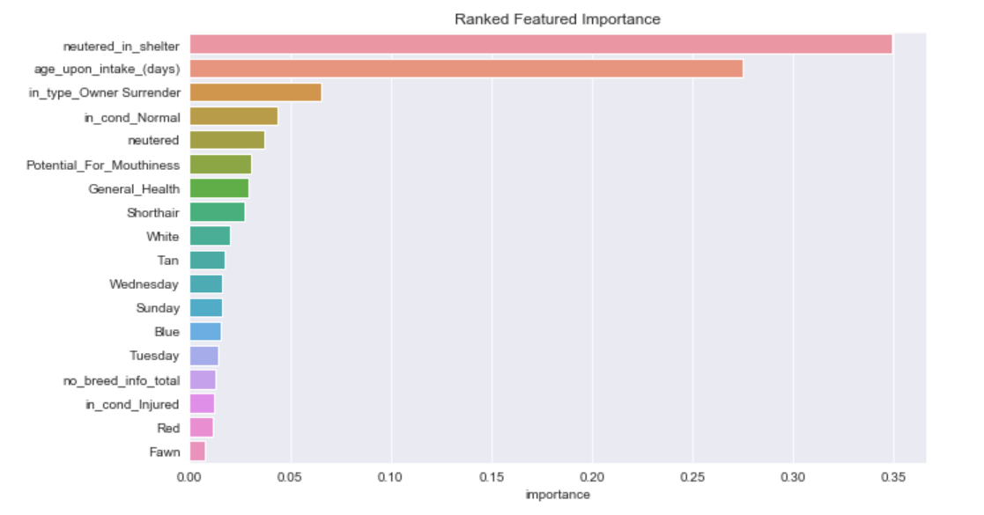
Algorithmic Feature Selection

Slide 34
Modeling
Used several model types to find best option
For each model algorithm, did a nested cross-validation:
random search to find the best hyperparameters
Cross-validation of the resulting model to determine predictive ability on test data

Slide 35
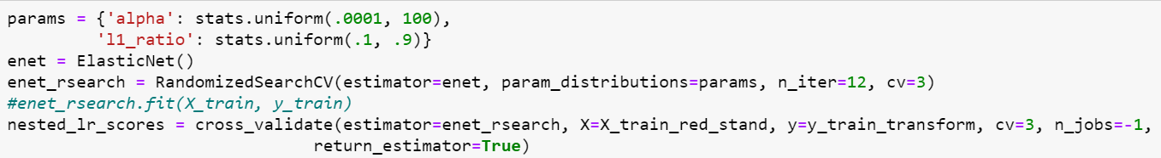
Linear Regression
Best option for explainable model
Used MinMax scaler on X
Test scores were approximately zero

Slide 36
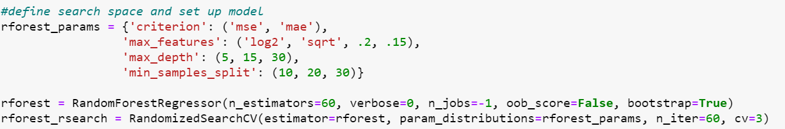
Tree-Based: Random Forests
Random Forest models can find interactions
Search parameters:
Mean adjusted R-squared: .25

Slide 37
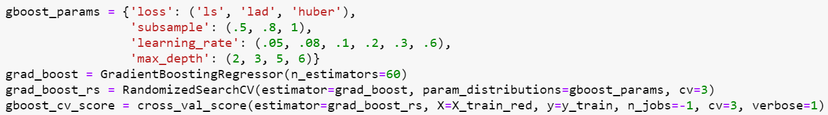
Tree-Based: Gradient Boosted Tree Ensembles
Search parameters:
Average Adjusted R-Squared: .25

Slide 38
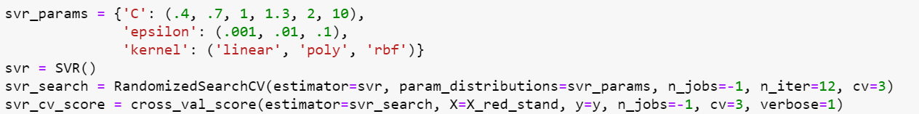
Other Models: Support Vector Machines
Support Vector Machines search parameters:
Mean Adjusted R-Squared: .18

Slide 39
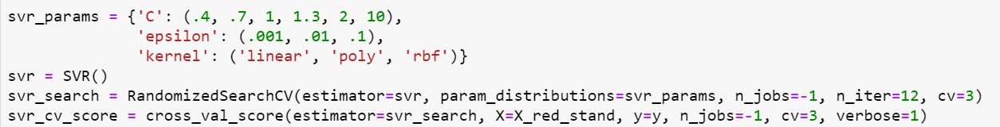
Other Models: K-Nearest Neighbors
KNR search parameters:
Mean Adjusted R-Squared: .23

Slide 40
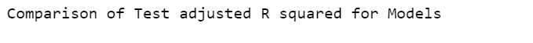
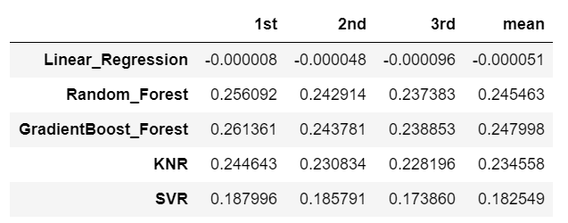
Model Score Comparison

Slide 41
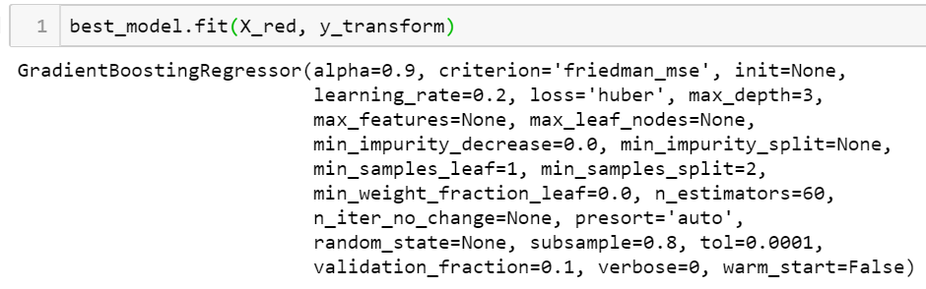
Chosen Model

Slide 42
Interpretation
I will use the gradient boosted tree model since it had somewhat better test scores than the other models.
The low score across models indicates that more information may be needed to improve the ability to predict time in the shelter.
This also indicates that the Austin Animal Shelter is doing a good job of ensuring all types of dogs are getting out of the shelter in a timely manner; not having trouble with a particular type of dog.

Slide 43
Interpretation
I did not find evidence that this shelter is having problems like ‘Black Dog Syndrome’

Slide 44
Features in Model
None of the features in the model have obvious distribution or statistically significant difference.

Slide 45
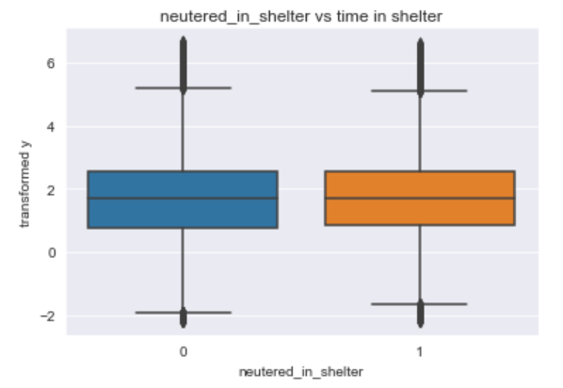
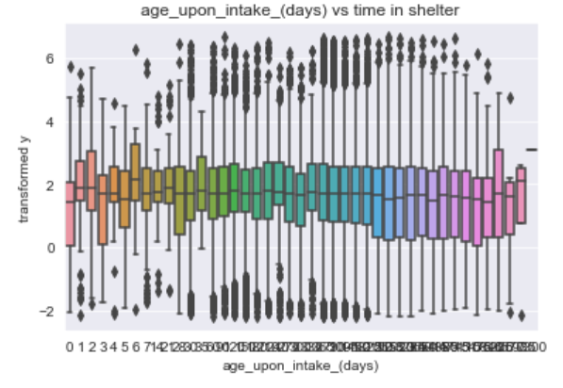
Features in Model

Slide 46
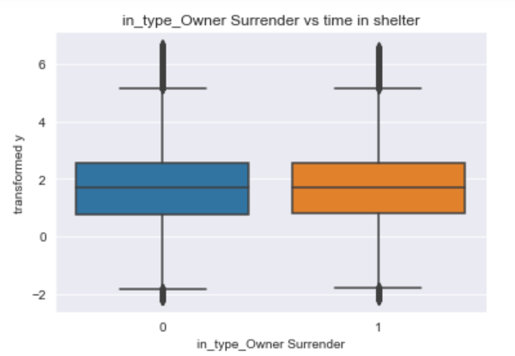
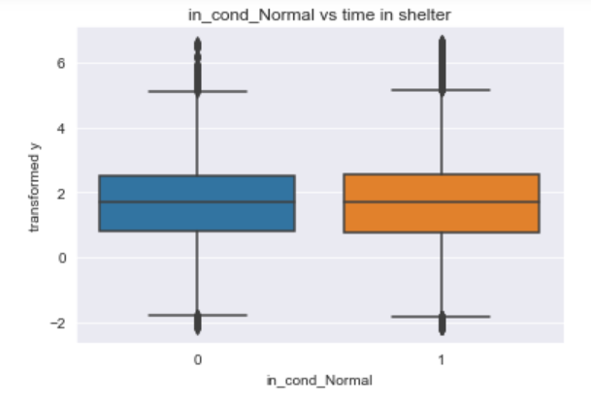
Features in Model

Slide 47
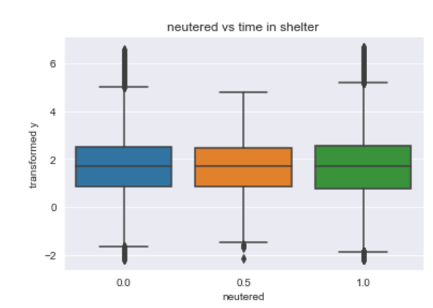
Features in Model

Slide 48
Error Distribution
Chosen gboost model was fit to the reduced set of features
Used to predict
Predicted values had boxcox transformation reversed
It appears the model is mainly picking up on a set of predictable stay lengths around 40-75 days
The very long stays are not being predicted as such by the model

Slide 49
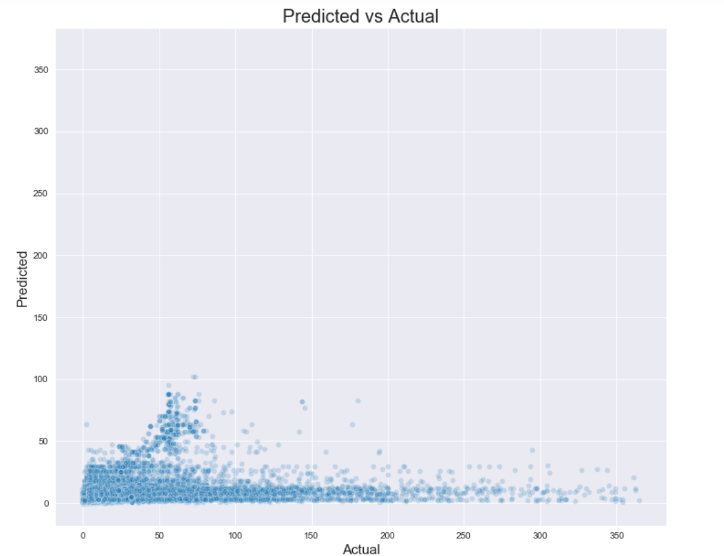
Error Distribution

Slide 50
Further Study
Modeling outcome categories (such as Adoption, Return to Owner, etc. ) as a predicted variable
Looking for additional variables that might influence the amount of time the animals stay in the shelter.

Slide 51
Conclusion
About ¼ of variability in length of stays at the Austin Animal Shelter can be predicted using a gradient boosted trees model
Most important features are neutering in the shelter, and age of animal
More data collection is needed to determine why some animals stay for very long periods

